Slide 1
Decision Tree
Geometric Intuition

Slide 2



Geometric Intuition
Key Points to remember
Decision Trees – Programmer think as if and else condition
It’s a nested if else condition classifier
If PL < a then class 1
else
if SL < b
class = 2
else
class = 3
Highly interpretable
Corresponding to every decision there is a plane $π$
All of the hyper planes are axis parallel
$$π_{1}$$
PL < a
Root Node
Class 3
y
n
Sepal Length
Class 1
Internal Nodes
Class 1
SL < b
b
$$π_{2}$$
y
n
Leaf Node
Class 2
Class 2
Class 3
a
Petal Length

Slide 3
Small Example
Key Points to remember
Outlook | Temperature | Humidity | Windy | Play
Sunny | Hot | High | False | No
Sunny | Hot | High | True | No
Overcast | Hot | High | False | Yes
Rainy | Mild | High | False | Yes
Rainy | Cool | Normal | False | Yes
Rainy | Cool | Normal | True | No
Overcast | Cool | Normal | True | Yes
Sunny | Mild | High | False | No
Sunny | Cool | Normal | False | Yes
Rainy | Mild | Normal | False | Yes
Sunny | Mild | Normal | True | Yes
Overcast | Mild | High | True | Yes
Overcast | Hot | Normal | False | Yes
Rainy | Mild | High | True | No
Outlook
Sunny
Overcast
Rainy
Humidity
Yes
Wind
High
Normal
True
False
No
Yes
No
Yes

Slide 4
Building a Decision Tree: Entropy
Key Points to remember

Slide 5
Assessment
Q1. What is the assumption of Logistic Regression?
The distance between the points are the most important factor in the Logistic Regression.
The data should be linearly or almost linearly separable
Logistic Regression can work on any type of data there is no assumption as such
The points should be linear in nature

Slide 6

Assessment
Q2. Which if the following condition is True?
If $y_{i}= +1 \left(+ve\right) and w^{T}x_{i}>0 then y_{i}w^{T}x_{i }>0,$Plane is correctly classifying the point
If $y_{i}=−1 \left(−ve\right) and w^{T}x_{i}>0 then y_{i}w^{T}x_{i }>0,$Plane is correctly classifying the point
If $y_{i}= +1 \left(+ve\right) and w^{T}x_{i}<0 then y_{i}w^{T}x_{i }>0,$Plane is correctly classifying the point
If $y_{i}= +1 \left(+ve\right) and w^{T}x_{i}<0 then y_{i}w^{T}x_{i }<0,$Plane is correctly classifying the point

Slide 7
Assessment
Q3. In the equation of the plane $π= w^{T}x+b=0,$ which option is correct about w, x and b?
w and x are vectors and b is a scalar
w is a scalar, x and b are vectors
w and b are scalars and x is a vector
w and b are vectors and x is a scalar

Slide 8
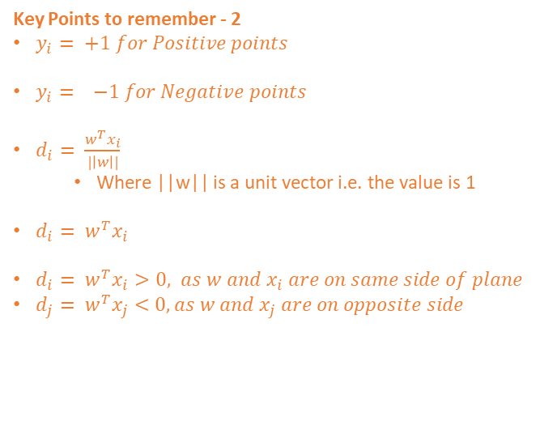
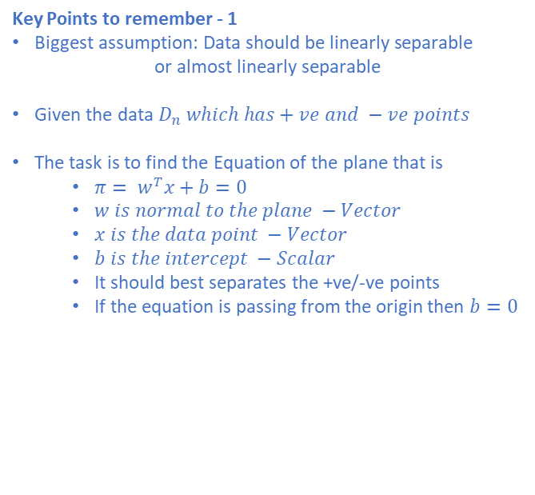

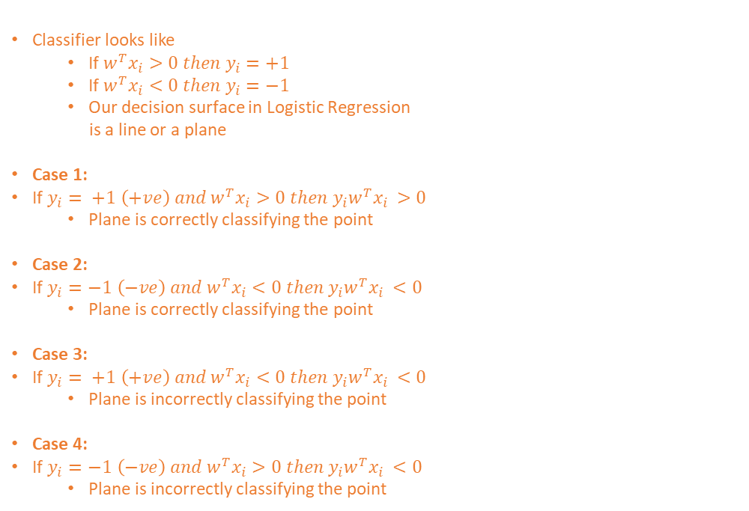
Logistic Regression – Geometric Intuition Cheat Sheet
Key Points to remember - 1
$\text{Biggest} \text{assumption}\text{: }\text{Data} \text{should} \text{be} \text{linearly} \text{separable}$
$$\text{or} \text{almost} \text{linearly} \text{separable}$$
$\text{Given} \text{the} \text{data} D_{n} which has+ve and −ve points$
The task is to find the Equation of the plane that is
$π= w^{T}x+b=0$
$w is normal to the plane −Vector$
$x is the data point −Vector$
$b is the intercept −Scalar$
It should best separates the +ve/-ve points
If the equation is passing from the origin then $b=0$
Classifier looks like
If $w^{T}x_{i}>0 then y_{i}=+1$
If $w^{T}x_{i}<0 then y_{i}=−1$
Our decision surface in Logistic Regression
is a line or a plane
Case 1:
If $y_{i}= +1 \left(+ve\right) and w^{T}x_{i}>0 then y_{i}w^{T}x_{i }>0$
Plane is correctly classifying the point
Case 2:
If $y_{i}=−1 \left(−ve\right) and w^{T}x_{i}<0 then y_{i}w^{T}x_{i }<0$
Plane is correctly classifying the point
Case 3:
If $y_{i}= +1 \left(+ve\right) and w^{T}x_{i}<0 then y_{i}w^{T}x_{i }<0$
Plane is incorrectly classifying the point
Case 4:
If $y_{i}=−1 \left(−ve\right) and w^{T}x_{i}>0 then y_{i}w^{T}x_{i }<0$
Plane is incorrectly classifying the point
Key Points to remember - 3
$For classifier to be very good we need to have$
Minimum # of incorrect classification
Maximum # of correct classification
i.e. $y_{i}w^{T}x_{i }>0$(As high as possible)
So in nutshell we need a plane $π or w that will$
Maximize $y_{i}w^{T}x_{i }$
$w^{∗}= Argmax$ $_{w^{ }} \sum_{i=1}^{n}{y_{i}w^{T}x_{i }}$
Here only w is variable rest all coming from the data
$w^{∗}=Optimal w$
This is the optimization problem we need to solve
Key Points to remember - 2
$y_{i}= +1 for Positive points$
$y_{i}= −1 for Negative points$
$d_{i}= \frac{w^{T}x_{i}}{|\left|w\right||}$
Where ||w|| is a unit vector i.e. the value is 1
$d_{i}= w^{T}x_{i}$
$d_{i}= w^{T}x_{i}>0, as w and x_{i} are on same side of plane$
$d_{j}= w^{T}x_{j}<0, as w and x_{j} are on opposite side$

